Slide 1
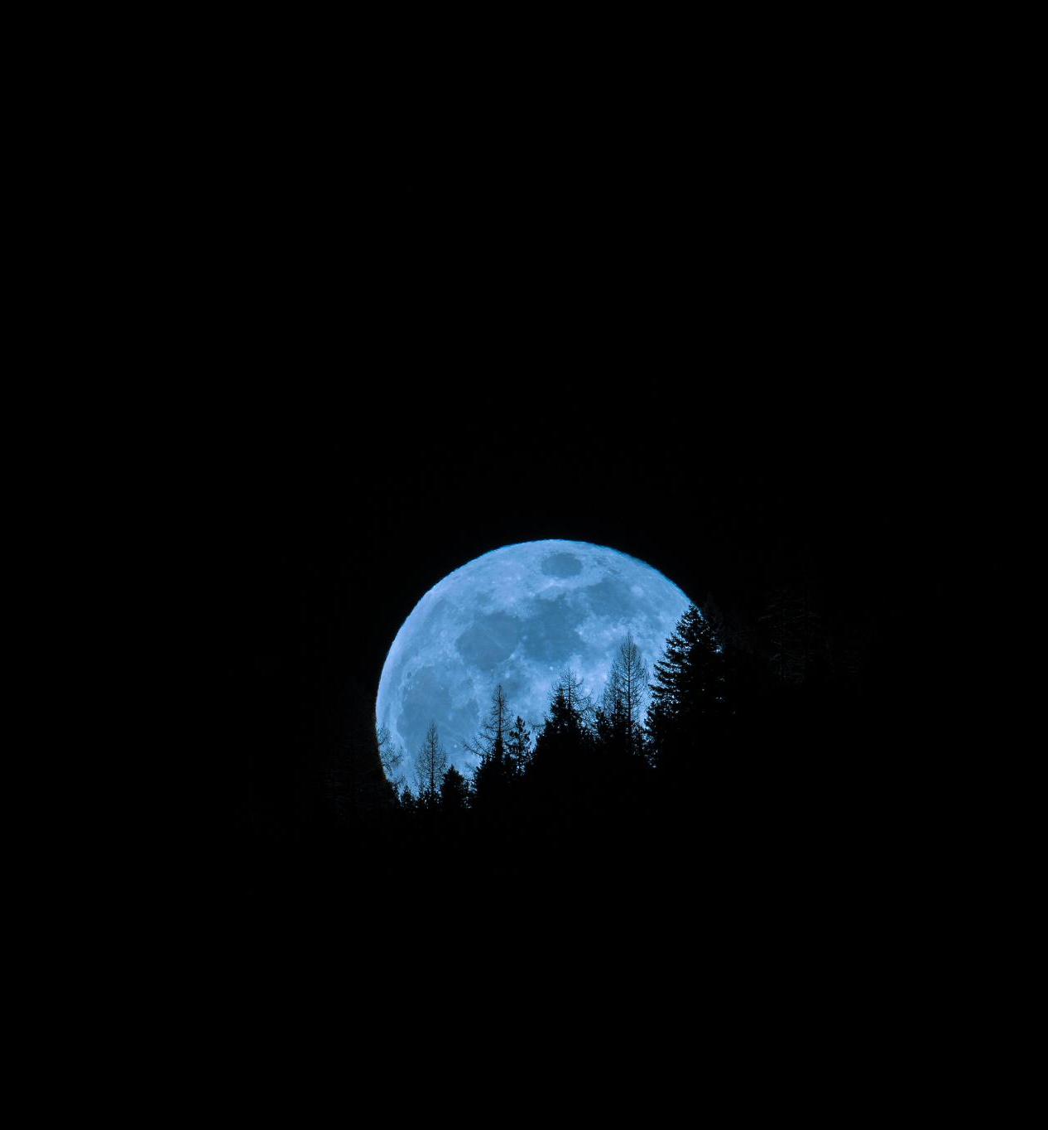
Rules
Each presenter starts, and every 20 seconds, their slides automatically advance
Each slides is filled with unrelated images, graphs, and diagrams
Notes:
--- In this session, we will dive into ten diverse topics ranging from the beauty of nature to the excitement of space exploration. Each topic is designed to ignite your creativity and provide a platform for spontaneous storytelling. Image source: Microsoft 365 content library

Slide 2
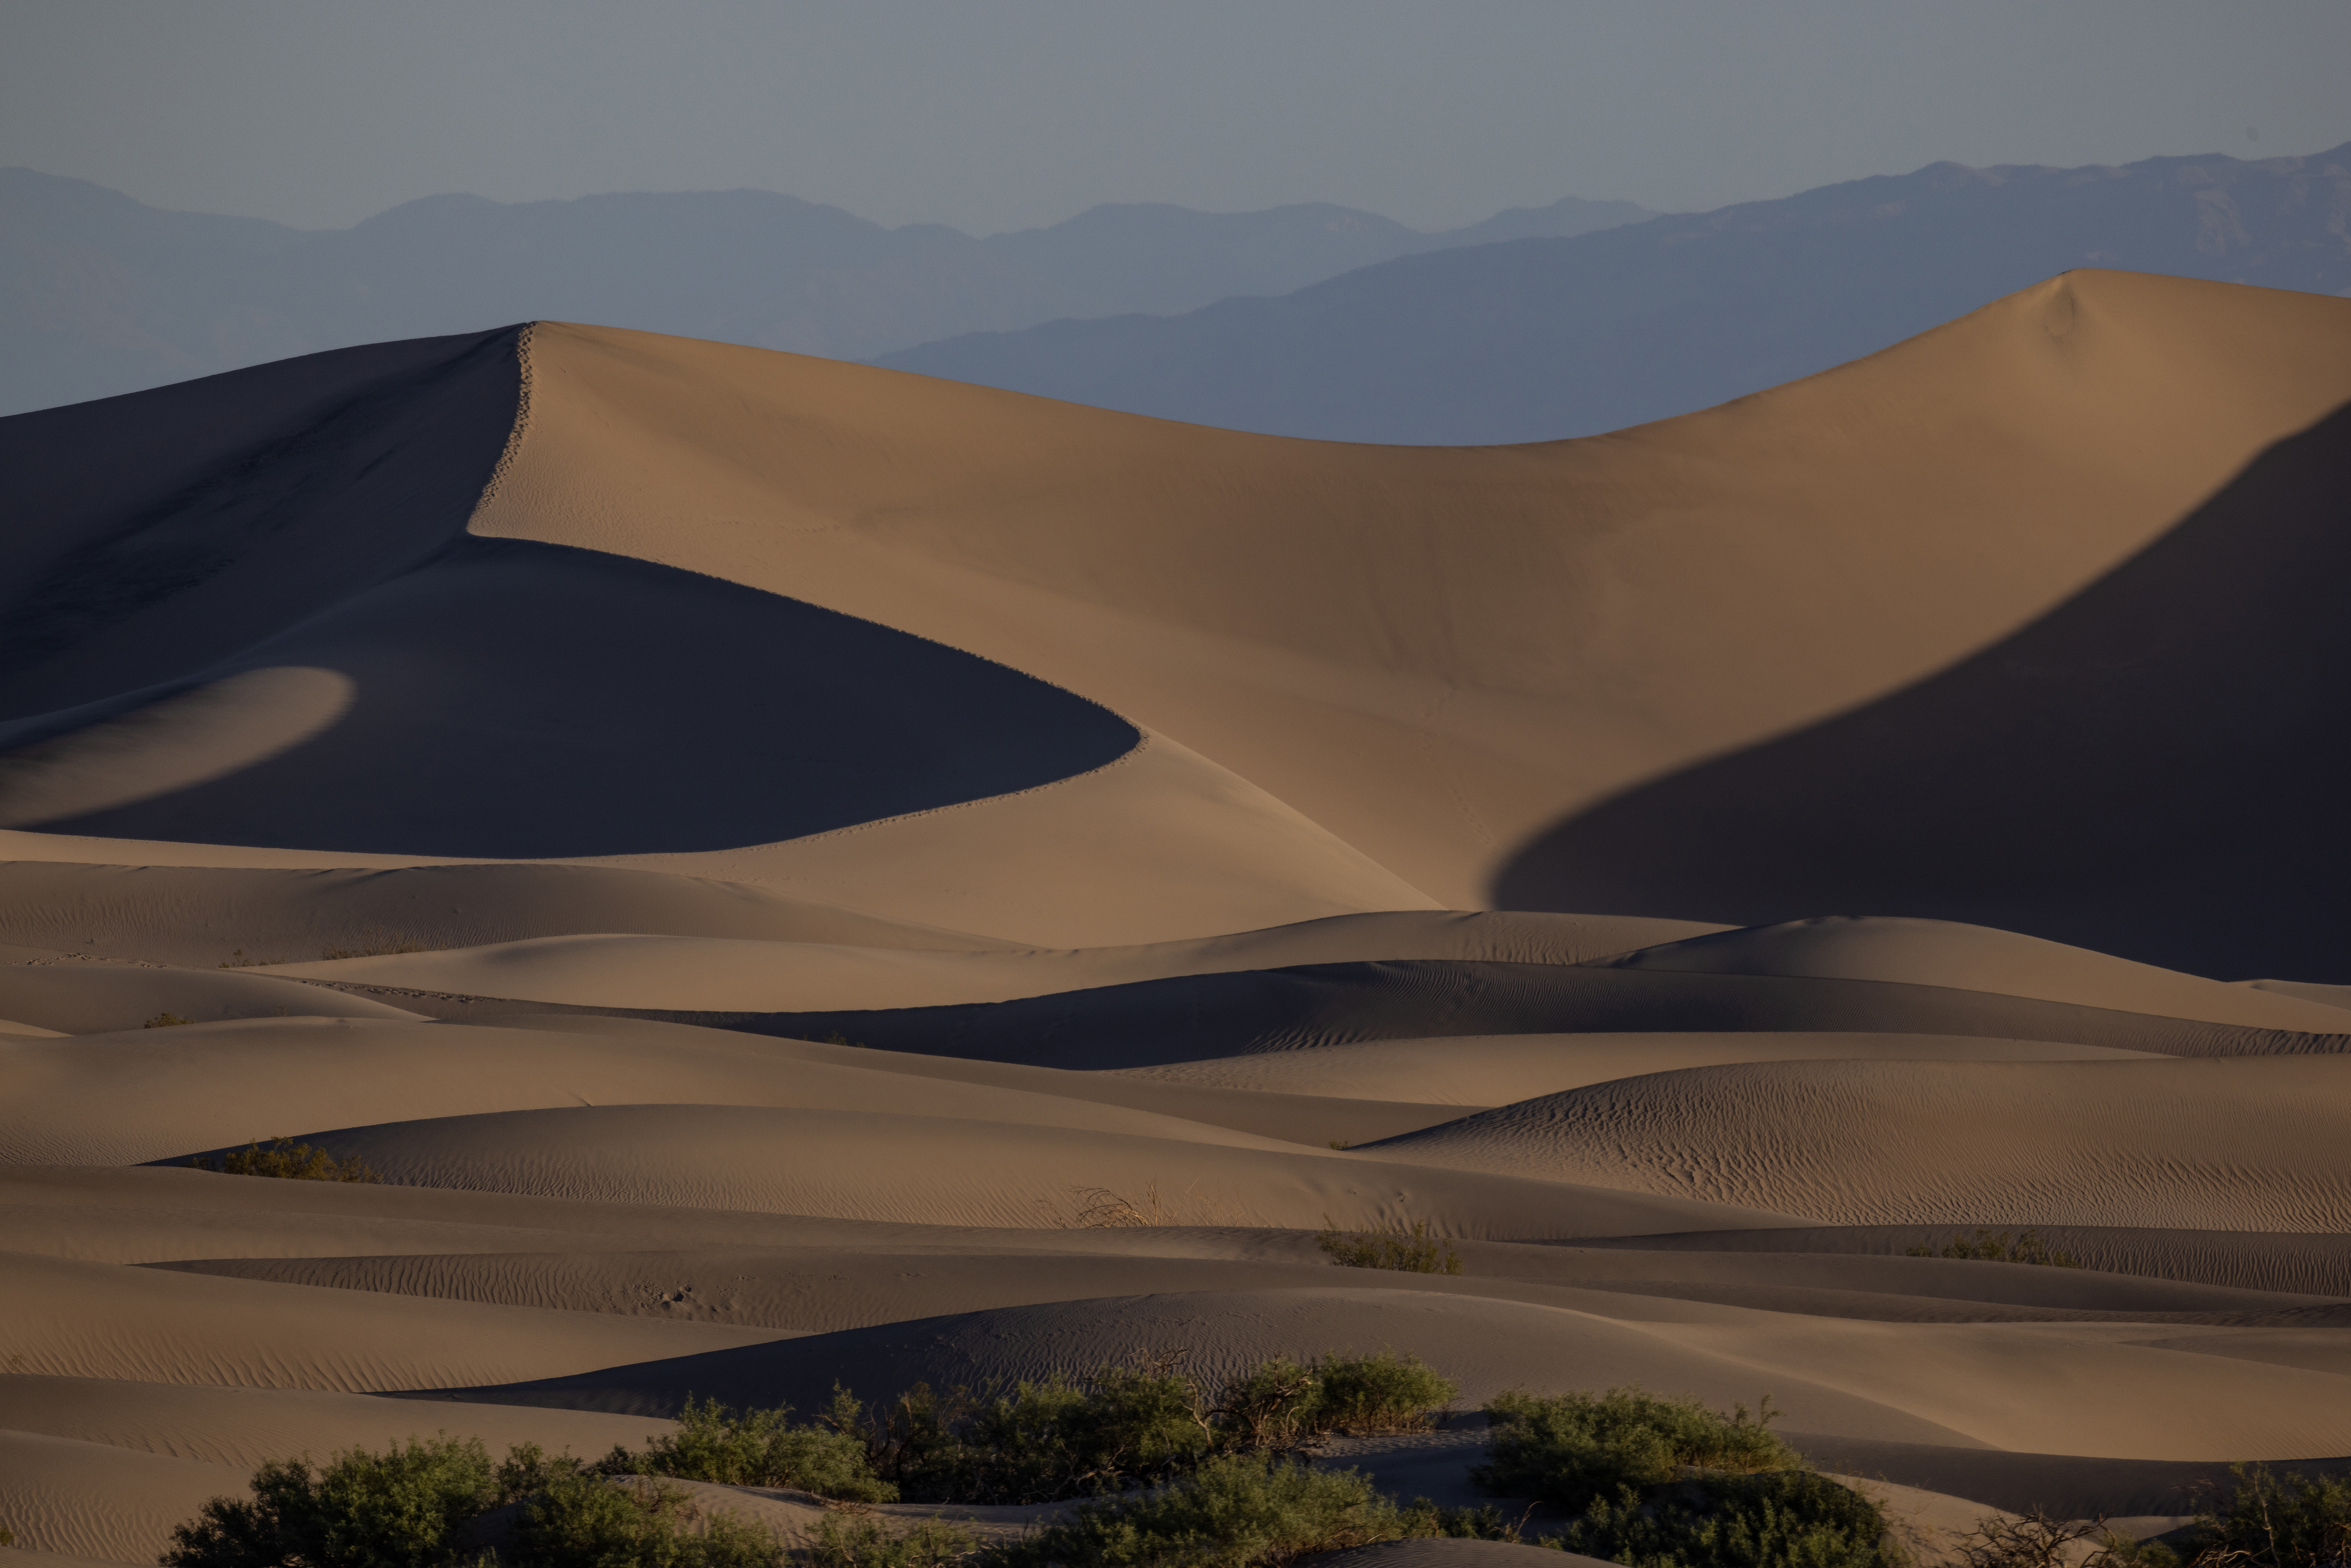
Notes:
--- Nature's grandeur is best experienced in the mountains, where stunning landscapes meet fresh air. The beauty of majestic mountain ranges provides a peaceful escape for all nature lovers. Image source: Microsoft brand library

Slide 3
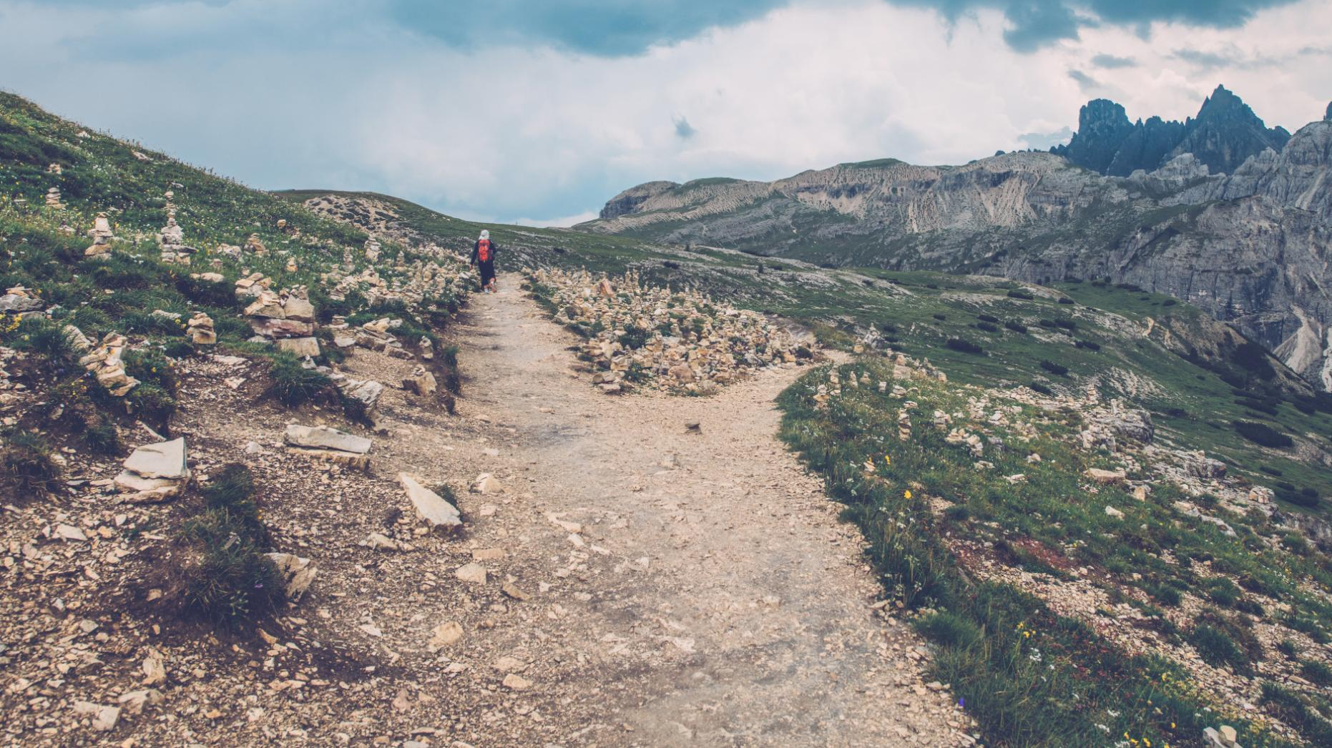
Notes:
--- Hiking trails in mountainous regions offer adventurous experiences for all skill levels. From beginner paths to challenging climbs, there's always a new adventure waiting in the great outdoors. Image source: Microsoft 365 content library

Slide 4

Notes:
--- Car shows gather passionate enthusiasts who share their love for vintage automobiles. Collectors pride themselves on preserving these classic cars for future generations to appreciate. Image source: Microsoft 365 content library

Slide 5

Notes:
--- Pet fashion has exploded in popularity, with unique styles and trends emerging. From seasonal costumes to themed outfits, pets are donning apparel that showcases their personality. Image source: Microsoft 365 content library

Slide 6
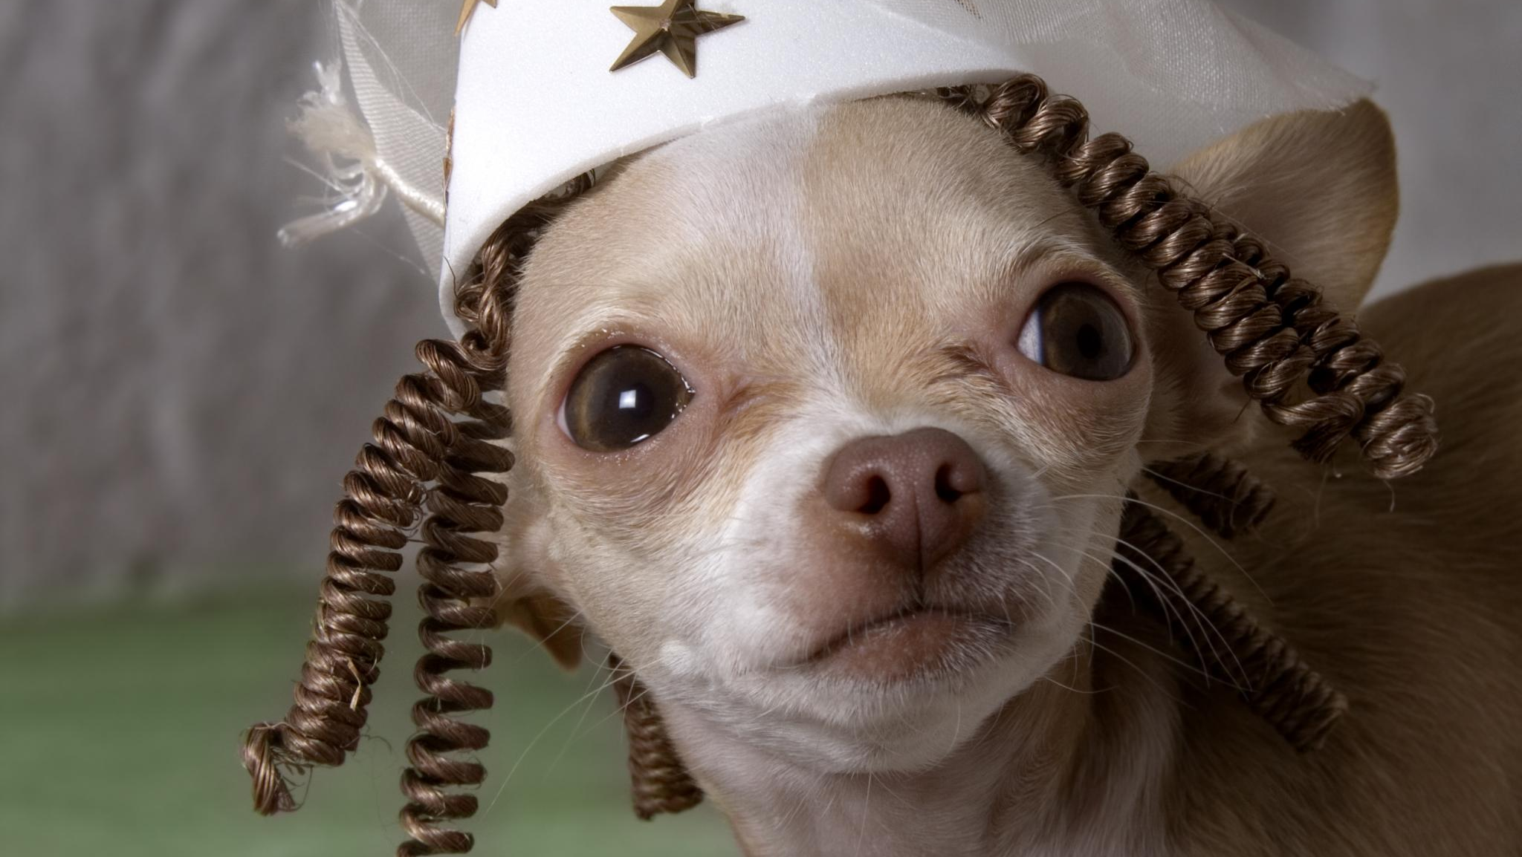
Notes:
--- Dressing up pets is not just about fashion; it’s about creating memorable moments. Watching a pet in a funny costume can brighten anyone's day and provide endless entertainment. Image source: Microsoft 365 content library

Slide 7

Notes:
--- Living in a metropolitan city provides access to diverse cultures, entertainment, and opportunities. However, it also brings the challenges of fast-paced living and crowded spaces. Image source: Microsoft brand library

Slide 8
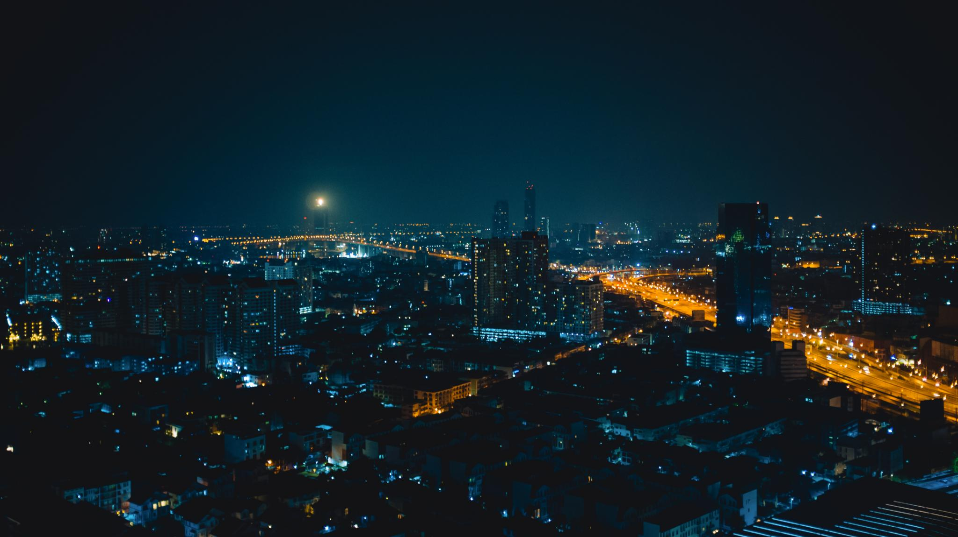
Notes:
--- Urban nightlife is bustling with activity, from restaurants to clubs and late-night events. The city's energy transforms after dark, offering countless experiences for night owls. Image source: Microsoft 365 content library

Slide 9
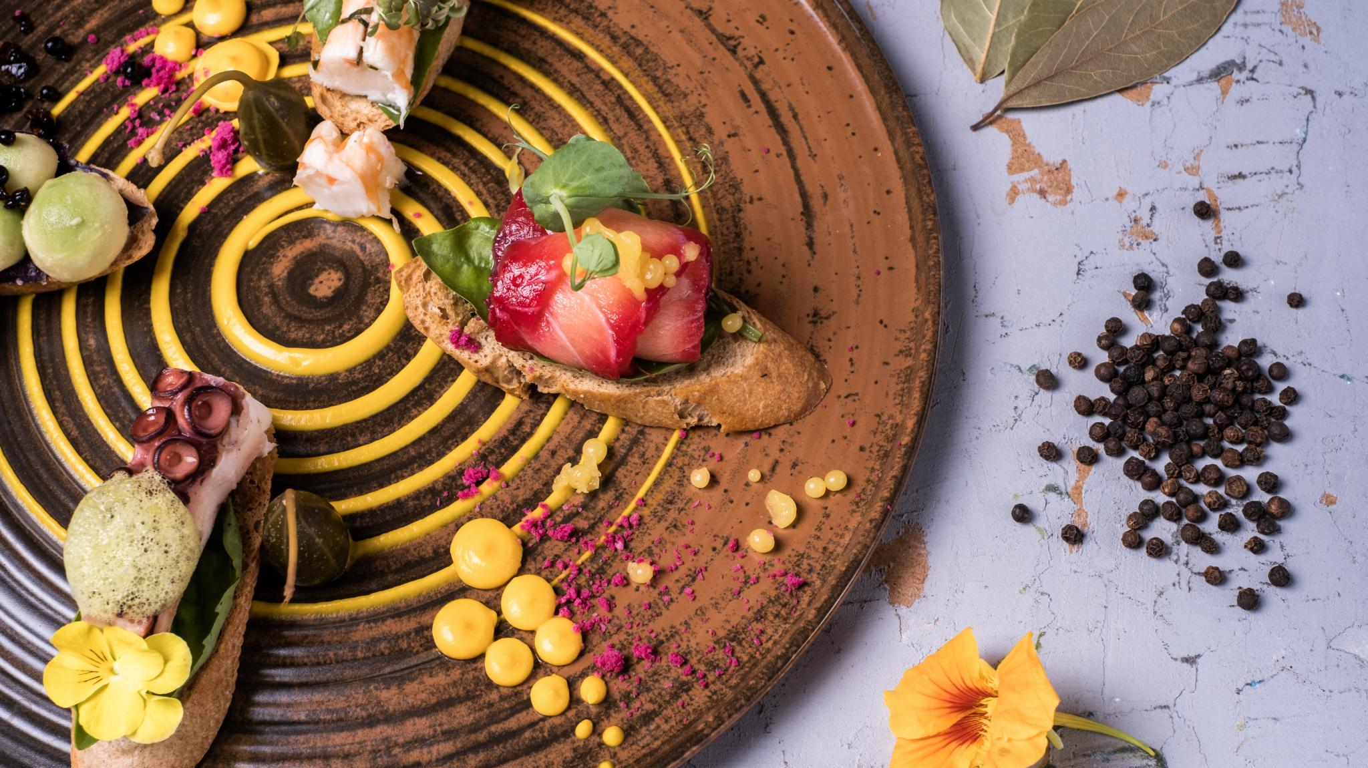
Notes:
--- The culinary arts involve creativity and skill, where chefs create gourmet meals that tantalize the taste buds. Understanding flavors and techniques is essential to gourmet cooking. Image source: Microsoft 365 content library

Slide 10
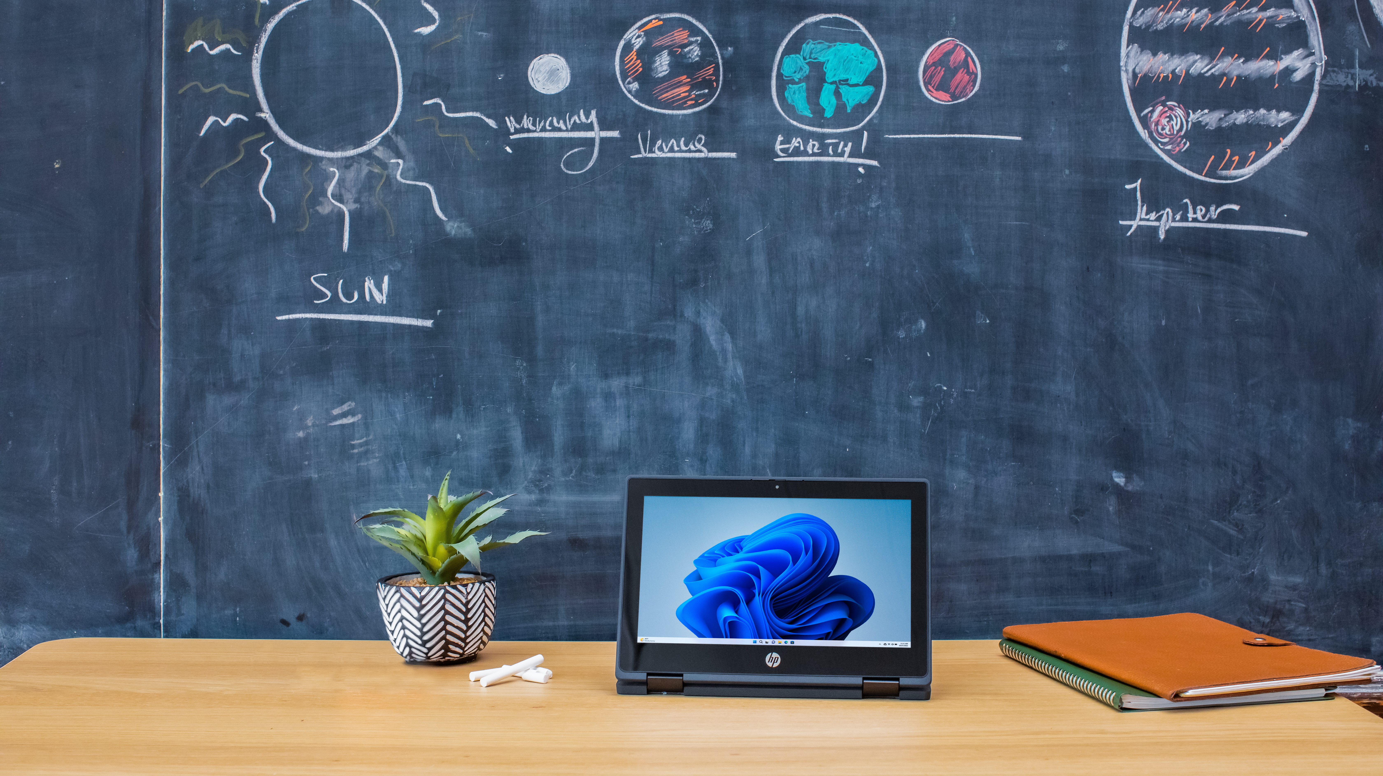
Notes:
--- Advancements in technology have revolutionized space exploration, allowing us to reach new heights and understand our universe better. Each launch brings us closer to unraveling its mysteries. Image source: Microsoft brand library

Slide 11

Notes:
--- Listening to music on a vintage record player offers a warm, rich sound that many enthusiasts cherish. The tactile experience of handling records adds to the nostalgia. Image source: Microsoft 365 content library

Slide 12

Notes:
--- Beach vacations are synonymous with relaxation. The soothing sound of the ocean and the warm sun create the perfect atmosphere for rest and rejuvenation. Image source: Microsoft 365 content library

Slide 13
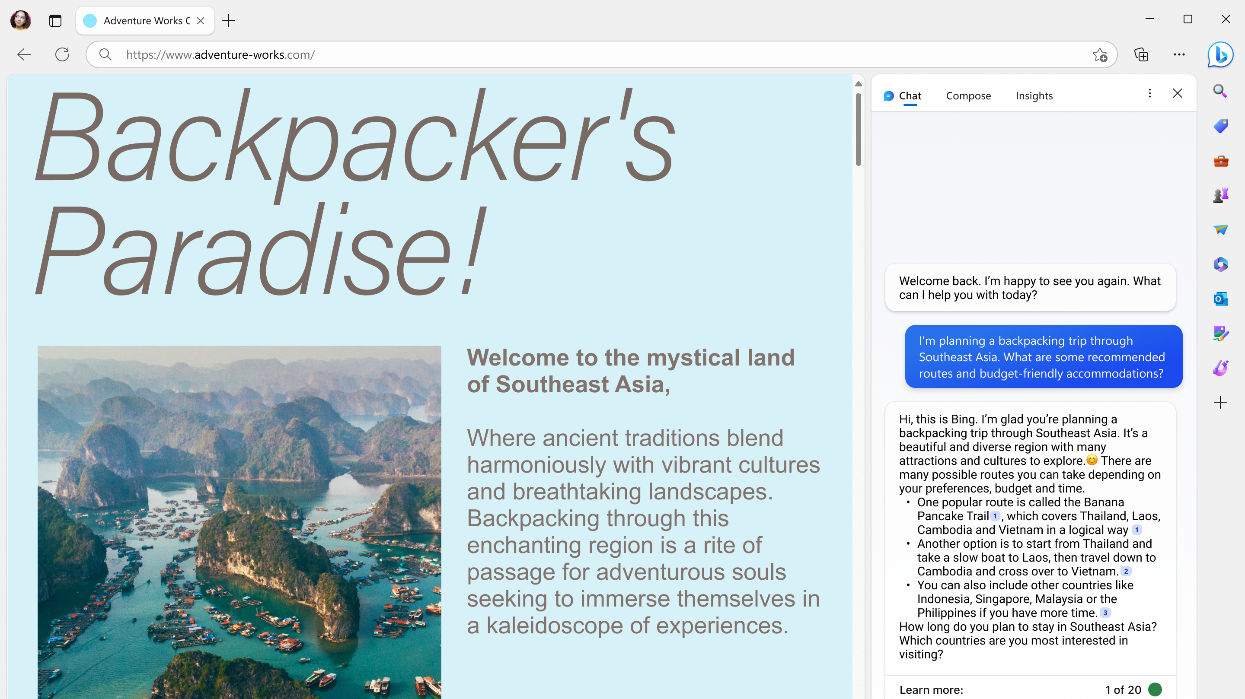
Notes:
--- Hot air ballooning is an exhilarating experience, providing a serene yet thrilling way to view the world from above. It combines adventure with the beauty of nature. Image source: Microsoft brand library

Slide 14
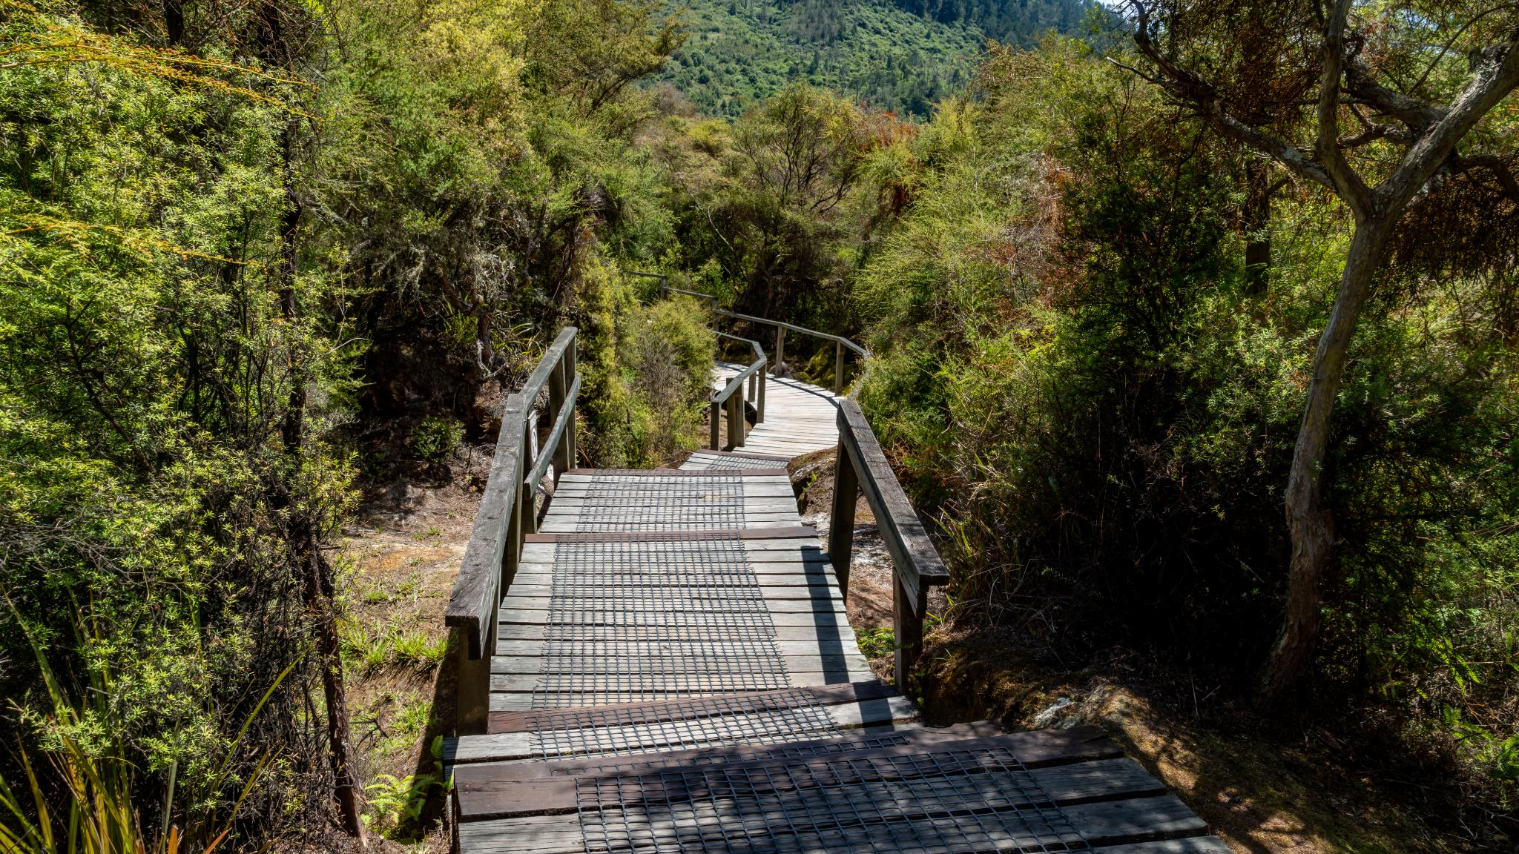
Notes:
--- Engaging in outdoor activities like hiking promotes physical health and mental well-being. Nature provides a refreshing escape that rejuvenates the spirit. Image source: Microsoft 365 content library

Slide 15
Conclusion
Notes:
Today, we journeyed through a variety of topics, celebrating nature, nostalgia, culinary delights, and the thrill of adventure. Random PowerPoint Karaoke is a fun way to explore and connect with the world around us.

